Slide 1
Intro to Coding with Python– Classes Pt 2
Dr. Ab Mosca (they/them)
Slides based off slides courtesy of Jordan Crouser (https://jcrouser.github.io/)

Slide 2
Plan for Today
Object-Oriented Programming
Big idea
recap classes
public vs private

Slide 3
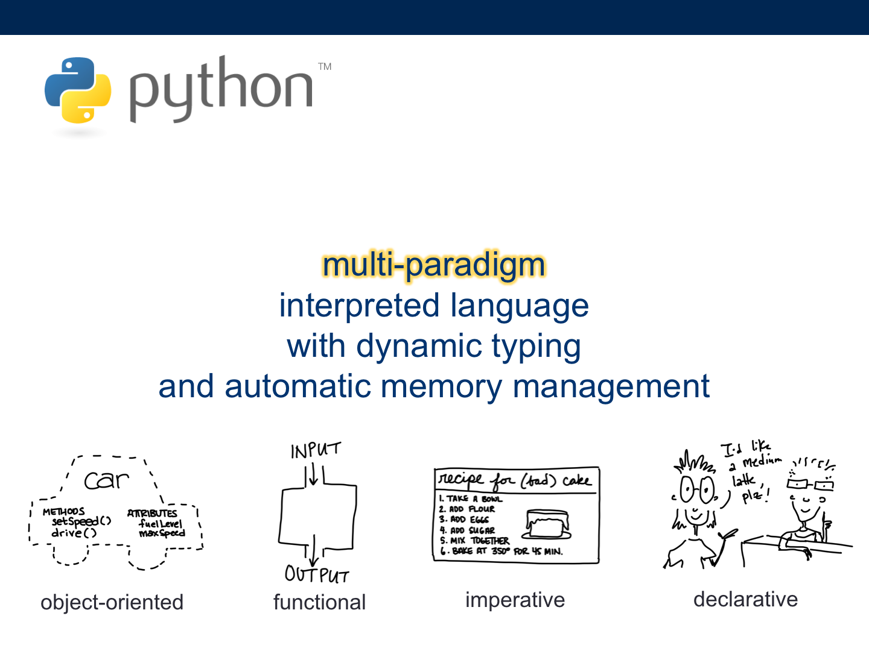
Remember back to the very beginning…

Slide 4
Imperative (“procedural”) programming
Program is structured as a set of steps (functions and code blocks) that flow sequentially to complete a task

Slide 5
Object-oriented programming (“OOP”)
Program is structured as a set of objects (with attributes and methods) that group together data and actions

Slide 6
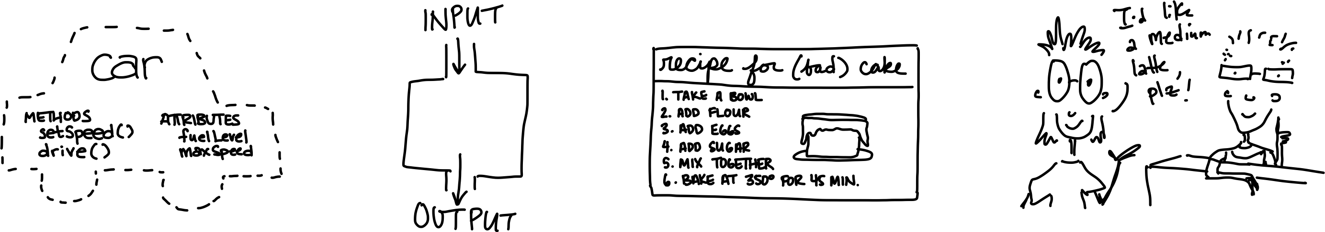
Comparison: pros and cons
Object-oriented
(a.k.a. “OOP”)
Imperative
(a.k.a. “procedural”)

Slide 7
Comparison : pros and cons
Object-oriented
(a.k.a. “OOP”)
more organized (logically)
matches the real world
easier to test / debug
easier to reuse code
more “overhead” (need to plan out further in advance)
harder to learn
overkill for small tasks
Imperative
(a.k.a. “procedural”)
easy to learn and implement
only need to think a few steps ahead
much more straightforward
can be hard to follow returns
have to pass stuff around
gets “unwieldy” / “clunky”
hard to test / debug
CONS PROS
Notes:
Procedural PROS
easy to implement
easy to learn (that’s why we started with it)
simple, straightforward structure
good for simple tasks
Procedural CONS
Difficult scale and hard to reuse
Hard to test
Very “flat” structure
Not good for larger applications (gets unwieldy fast)
Hard to maintain
OOP PROS
Much easier to scale
Good for larger, more complex tasks
Easier to test
More flexible structure
Easier to maintain and extend
OOP CONS
Architecture can be complicated, harder to “read”
Takes way more time to get started
Harder to learn

Slide 8
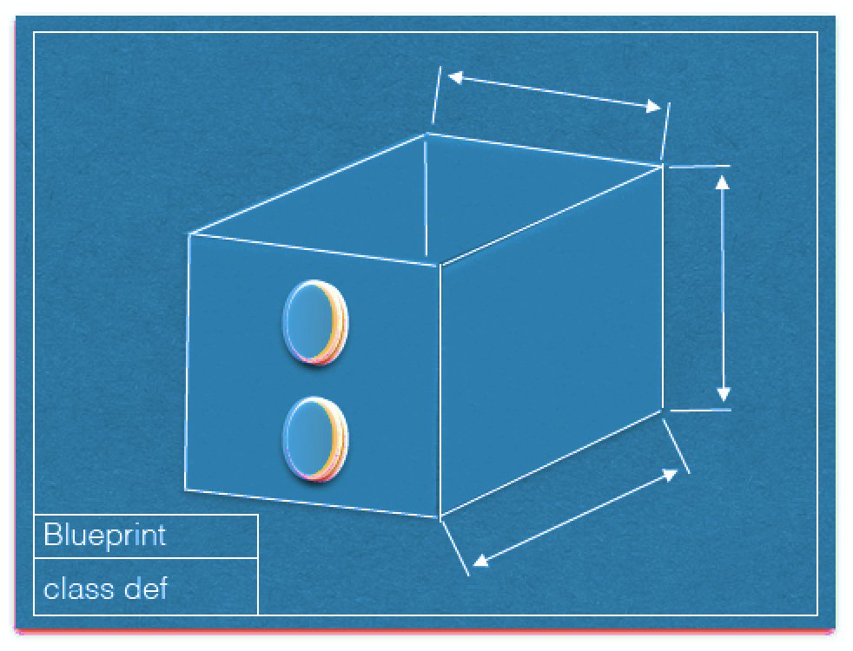
RECAP: class definitions (“blueprints”)
attributes
methods()
Image courtesy Dominique Thiebaut, Smith College

Slide 9
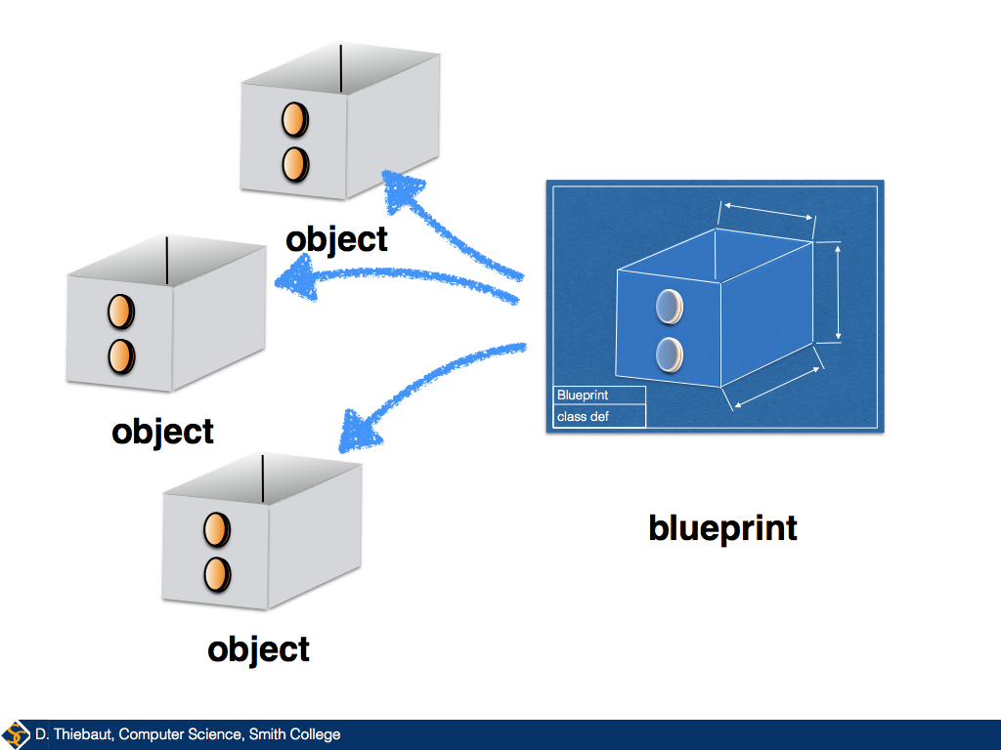
From a blueprint, we can make instances

Slide 10
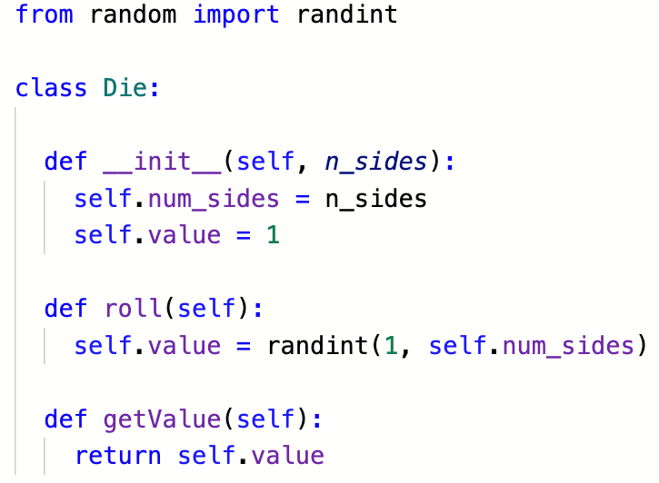
Coding the Die class

Slide 11
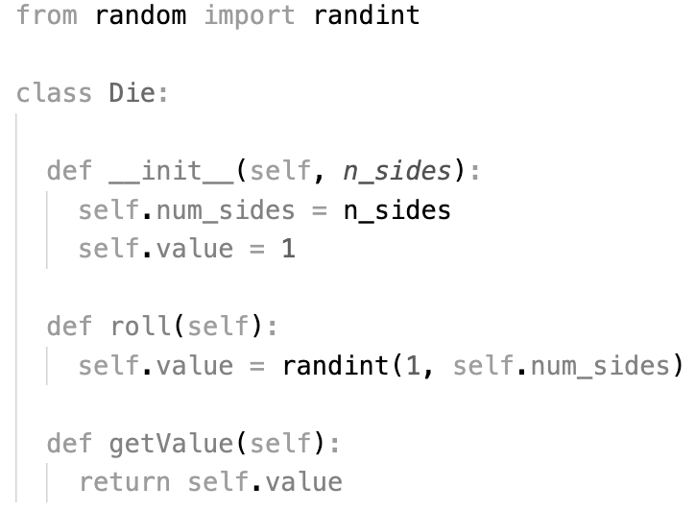
Coding the Die class
the
constructor

Slide 12
Coding the Die class
attributes

Slide 13
Coding the Die class
methods

Slide 14
What happens if I run this program?
Notes:
Nothing! We didn’t actually MAKE a song. We just made blueprints for a song – a description of what a Die should know about itself (num_sides, current_value, etc.), and what it should be able to do (print and play).

Slide 15
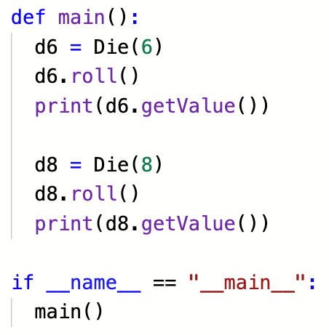
Using the class

Slide 16
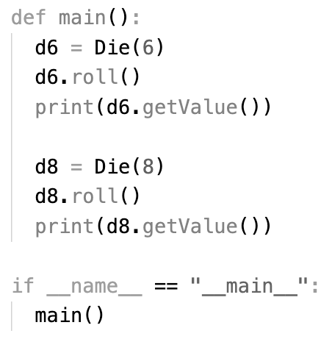
Creating Die instances
call the constructor

Slide 17
Lots of possible Die instances
they don’t all
have the same
attributes

Slide 18
All from the same blueprint

Slide 19
class definition vs. instance
…make sense?

Slide 20
Lingering question
“Why can’t I just access attributes directly?”

Slide 21
Think back to our ATM example
Can you imagine any attributes/methods you might want to be private?
print(account.pin)

Slide 22
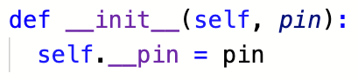
public vs. private
python methods/attributes are public by default this means that they can be accessed from outside the instance… by anyone (for better or for worse)
To make a method/attribute private (i.e. accessible only within the instance itself), prefix it with a double underscore (_ _)

Slide 23
15-minute exercise
Create a class to represent this class (CAIS 117)
Which attributes should be private and which should be public?
Once you have your class, write a program that makes an instance of that class and prints that names of everyone in class

Slide 24
Big takeaways
Object-oriented programming is a powerful paradigm
It’s also very common (and therefore useful to learn)
The more complex your problem, the more it makes sense to organize your code this way
In Python, it isn’t all or nothing: some parts of your program might be object-oriented, others might be procedural
The important part is that your code makes sense

